Slide 1
Software Testing and Quality Assurance
Lecture 15

Slide 2
Agenda
Course description and outline
Motivation and Requirement for Software Testing and Quality Assurance
Software Quality Attributes
Software Quality Engineering
Quality Standards

Slide 3
Description and Objectives
This course introduces the student fundamental notions of software quality and the techniques used to build and check quality in software systems.
A particular emphasis is placed on quantitative assessment of software quality and quality control using software testing techniques
This course aims to equip the students with a good grasp of software quality metrics and models.
The students would learn software testing techniques and software reliability analysis techniques.

Slide 4
Outline
Software Quality: Overview and Introduction
Basic Introduction.
Software Quality Attributes.
Introduction to Quality Engineering.
Testing: Concepts, Issues, and Techniques
Introduction to software testing.
Software testing lifecycle.
Testing Scopes.
Testing Approaches.
Testing Concepts.
Test Planning Process
Introduction to testing process
Requirement of software test planning
Testing documentation
Reporting and historical data recording.

Slide 5
Outline
Software testing techniques
Testing philosophies
Testing strategies
Model based testing:
Testing using models: Using finite state machine
Control-flow and dataflow based testing
Domain and combinatorial testing
Unit and integration testing
Unit testing
Integration testing
Acceptance testing
Slicing
Introduction
Different forms of slicing
Slicing and testing

Slide 6
Outline
Software reliability models and engineering
Introduction
Exponential model.
Reliability growth models
Modeling process
Software inspections
Fagan inspections
Software reviews
Inspection checks and metrics

Slide 7
Outline
Quality Models and Measurements
Introduction
Models for quality assessment
Product quality metrics
In-Process metrics for software testing
In-Process quality management
Effort/outcome models
Test harnesses, Oracles and automating testing
Implement test harnesses
Introduction to test oracles
Test automation

Slide 8
Quality (What, Why and Cost)
What is Quality
Conformance to explicitly stated functional and performance requirements, explicitly documented development standards, and implicit characteristics that are expected of all professionally developed software (Pressman)
The degree to which a system, component, or process meets specified requirements. The degree to which a system, component, or process meets customer or user needs or expectations (IEEE)
Why Quality
You would not like MS Office to occasionally save your documents
Competitiveness of International Market
Cost of Quality
Software bugs, or errors, are so prevalent and so detrimental that they cost the U.S. economy an estimated $59.5 billion annually, or about
0.6 percent of gross domestic product. (US Dept of Commerce, 2002)
– Although all errors cannot be removed, more than a third of these costs, or an estimated $22.2 billion, could be eliminated by an improved testing infrastructure that enables earlier and more effective identification and removal of software defects. (US Dept of Commerce, 2002)

Slide 9
Some Definitions
Quality (Our running definition)
The totality of features and characteristics of a product, process of service that bear on its ability to satisfy stated or implied needs.
Error, Fault or Bug…
Software Error
–
–
A discrepancy between a computed, observed, or measured value or condition and the true, specified, or theoretically correct value or condition. This can be a misunderstanding of the internal state of the software, an oversight in terms of memory management, confusion about the proper way to calculate a value, etc.
Software Failure
The inability of a system or component to perform its required functions within specified performance requirements. See: bug, crash, exception, and fault.
Bug
A fault in a program which causes the program to perform in an unintended or unanticipated manner. See: anomaly, defect, error, exception, and fault. Bug is terminology of Tester
defect
Commonly refers to several troubles with the software products, with its external behavior or with its internal features.
Fault
An incorrect step, process, or data definition in a computer program which causes the program to perform in an unintended or unanticipated manner. See: bug, defect, error, exception.
–
–
–
Our Interest is finding faults while testing

Slide 10
Default Document for Quality
We need to know where are the stated or implied needs…
Against which we test if they are met
We refer to theses quality features and
characteristics as Quality Attributes
They are part of the Software requirements specification (SRS ) document
We employ Quality Control Techniques, Measurements, and Inspection techniques for this purpose

Slide 11
Typical Quality Assurance Attributes
Non-functional Requirements
Product transition related
Portability
Interoperability
Reusability
Product Operations related
Reliability
Robustness
Efficiency
Usability
Safety
Security
Fault-tolerance
Product revision related
Maintainability

Slide 12
Quality Attribute Examples
The system should be capable of processing 10 transactions per minute
The system should only allow authorized access.
The users should be forced to change their passwords every tenth usage
The system should maintain logs of disk activity on one disk to any other disk in the array in a fully redundant manner
…

Slide 13
Quality Assurance vs. Quality Control
Quality Assurance
It is fault prevention through process design and
auditing
Creating processes, procedures, tools, jigs etc., to prevent faults from occurring
Prevent as much as possible defect injection
Quality Control
It is fault/failure detection through static and/or dynamic testing of artefacts
It is examining of artefacts against pre-determined criteria to measure conformance

Slide 14
Quality Control Methods
Reviews
Personal, peer, pair, management, QA, independent
Testing
Structural, functional, integration, stress/performance, regression, field, acceptance
Simulations
Prototypes, models
Field Trials
Prototypes, beta testing
Mathematical
Proofs of correctness

Slide 15
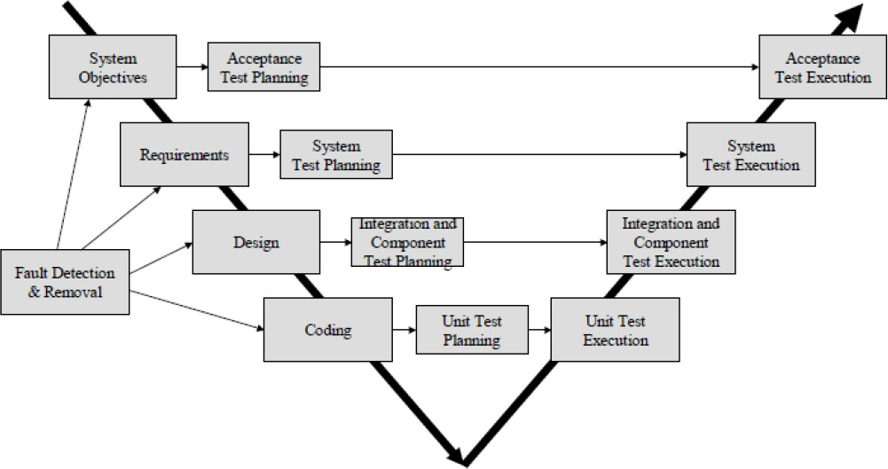
QC in Software lifecycle

Slide 16
Quality Assurance (on the other hand)
Software quality is the conformance to
explicitly stated functional and performance requirements,
documented development standards, and implicit characteristics
Product Improvement through Process Improvement
Main Focus
Processes how maintained
Handling of product how done
We focus the process by which the product is getting developed

Slide 17
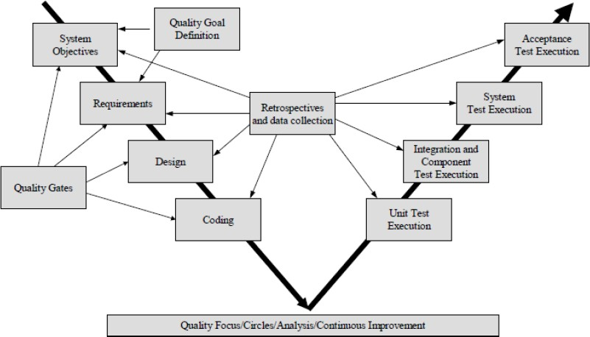
QA in Software lifecycle

Slide 18
Quality Standards
ISO 9000 standards
Capability Maturity Model (CMM)
Left to a next lecture…

Slide 19
Quality Planning
Software quality engineering is driven by the software quality plan
A quality plan is
a document setting out the specific quality practices, resources and activities to particular product, process, service, contract or project
Quality plan
Sets out the desired product qualities, and define how these are to be assessed
Select those organizational standards that the appropriate to a particular process and development processes

Slide 20
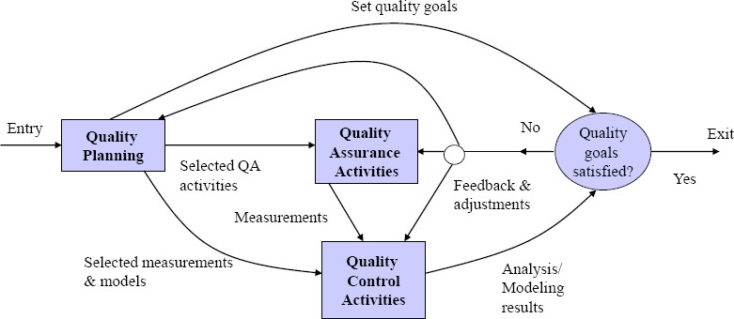
Quality Engineering Process
Iterative process which combines quality planning, quality assurance and quality control activities.
Our goal is:
– Defect prevention, reduction and containment

